Slide 1
Emerging Adulthood: Psychosocial Development of Ages 18-25
Chapter 19
Mariana
Kenny
Dana
Kymone
Guernise

Slide 2
Identity achieved Personality in emerging adulthood
Continuity and Change

Slide 3
Continuity and Change
In emerging adulthood, the legacy of early development is apparent amidst new achievement, as Erikson recognized in his description of the 5th of 8 stages, identity versus role confusion
Emerging adulthood resolves the identity crisis that began in adolescence.

Slide 4
Identity achieved
Erikson believed the outcome of earlier crises provides the foundation of each new stage.
Arenas of Identity
Religious commitments
Gender roles
Political loyalties
Career options

Slide 5
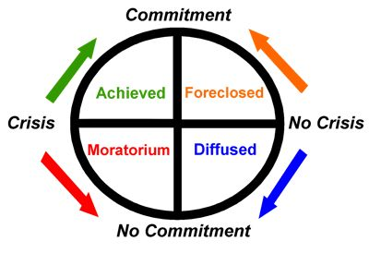
Identity Achieved
Moratorium: Postponing identity achievement while they explore possibilities, reduce pressure to achieve identity
Avoiding marriage with college
College requirements discourage foreclosure
Interdisciplinary course load
Other moratoria: military, religious mission work, apprenticeships, government, academe, and industry
Provides time to make achievements in political/ethnic identity

Slide 6
Ethnic Identity
In the United Sates and Canada, almost 50% of 18-25 year-olds are of African, Asian, Latino, or Native American heritage.
Emerging adults are particularly attuned to ethnic roots and future roles
Most emerging adults identify with very specific ethnic groups.
Adolescents may call themselves Asian-American; whereas adults specify as “Vietnamese-American”

Slide 7
Ethnic Identity
Ethnic identity is complex and pervasive, affecting language, manners, romance, employment, neighborhood, religion, clothing, and values.
It is reciprocal, both a personal choice and a response to others.
It depends on context, so it changes with time and circumstances
It is multifaceted; emerging adults accept some aspects and reject others

Slide 8
Ethnicity From You to Me
Emerging adults tend to have friends and acquaintances of many backgrounds as they become more aware of history, customs, and prejudices.
Realizing the importance of ethnicity for their classmates, Euro-Americans become more conscious of their own background.
Hispanic college students who resisted both assimilation and alienation fared best: They were able to maintain their ethnic identity, deflect stereotype threat, and become good students.

Slide 9
Colleges and Ethnicity
College classes attract many emerging adults who want to learn more about their own culture
Various extracurricular groups help solidify identity as students encounter others of similar backgrounds who confront the same issues.
Intimacy is aided by cultural similarity

Slide 10
The Other
Multiethnic identity: Young adult whose parents are from 2 ethnic groups
Pushed into being proudly biracial OR
Identify with whichever group experiences more prejudice
Immigrants: young adults whose parents were immigrants
They experience added stress because combining their past and future means reconciling their heritage with their new social context
They encounter attitudes from the native-born that make them reexamine their identity

Slide 11
Vocational Identity
Erikson’s industry v inferiority continues to evolve throughout early adulthood
Critical stage for the acquisition of resources : education, skills, and experience needed for life-long family and career success
Many attend college to prepare for a good job
Temp Jobs: between ages 18 and 27, avg US workers has held 8 jobs, with the college- educated changing jobs more than average.

Slide 12
Personality in Emerging Adulthood
After adolescence, new personality dimensions may appear and negative trails may diminish since emerging adults make choices that break with the past.
Freedom from marriage and parenthood allows shifts in attitude and personality.
Shifts toward positive development were also found in extremely shy and aggressive children.

Slide 13
Rising Self-Esteem
Attitudes continue and improve
Transitions such as moving away for college and getting married greatly increased well-being.
Those who became single parents or remained with parents make the least gains.
The many stresses and transitions of emerging adulthood might reduce self-esteem, but generally does not.
Most do not suffer from serious disorders.

Slide 14
Aggressive Children Grow Up
More likely to quit school and leave jobs before age 25
More conflicts with parents and friends when they became emerging adults
Like their peers in that they had an average amount of friends, pursued educated, and rate themselves conscientious.
Arrests were typically for minor offenses

Slide 15
Shy Children Grow Up
Inhibited children became cautious, reserved adults
slower than average to secure a job, choose a career, or find romance
Their delayed employment and later marriage were typical for new generation. What was considered to be a handicap in childhood may have become an asset.

Slide 16
Plasticity
How the brain is changed from experience
Changes such as leaving home, finding satisfying work one is good at might alter a person’s life course
Total change does not occur because of genes, childhood experiences, and family circumstances
Personality can shift in adulthood

Slide 17
friendship
Intimacy

Slide 18
Intimacy vs. Isolation
The sixth of Erikson’s eight stages of development
This stage takes place during young adulthood
Erikson believed that having a fully formed sense of self is essential to be able to form intimate relationships

Slide 19
Studies have demonstrated that those with a poor sense of self tend to have less committed relationships, and are more likely to suffer emotional isolation, loneliness, and depression.

Slide 20
Self-expansion
According to a more recent theory, an important aspect of close human connection is “self-expansion.”
Self-expansion – the idea that each of us enlarges our understanding, our experiences, and our resources through our intimate friend’s or partners.

Slide 21
Friendships
Unlike family members, friends are earned; they choose us.
Friend’s are positively correlated with happiness and self-esteem.

Slide 22
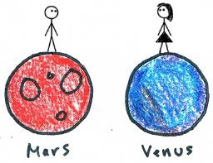
Friends in Emerging Adulthood
Men, by contrast, typically do things together- with outdoor activities frequently preferred.
Friendships between Women
Friendships between Men
Women tend to spend more time in intimate conversation, with more emotion than activity, perhaps commiserating rather than calling attention to their accomplishments.

Slide 23
Male-Female Friendships
Male-female friendships are less common for people at the extremes of gender identity (the very feminine girl or super masculine boy)

Slide 24
Romantic partners
Intimacy

Slide 25
Romantic Partners
Love, Romance, Lasting commitment is important for emerging adults
Postponing, not abandoning marriage
The relationship with love and marriage depends on era and culture
1/3 of the world’s families are arranged marriages
1/3 of adolescents meet with a select group
1/3 expected to fall in love, but not marry

Slide 26
Romantic Partners
The Dimensions of Love
Robert Sternberg(1988) described three distinct aspects of love
Passion
Intimacy
Commitment
The absence or presence of any three leads to 7 different forms of love(Table 19.3, Pg. 529)

Slide 27
Romantic Partners
The Ideal and the Real
The western ideal involves Passion, Intimacy, and commitment
A combination of what is seen in movies, and the reality of the experience
In a Developmental POV, it is hard to achieve
Sexual attraction is important, but not for a long-term relationship
“Friends with Benefits”

Slide 28
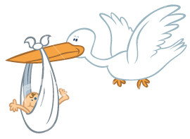
Romantic Partners
Hookups Without Commitment
In prior generations, it was either Prostitution or a “dirty secret”
Emerging Adults know their peers “hook-up”
No intimacy, no commitment
Differs between sexes

Slide 29
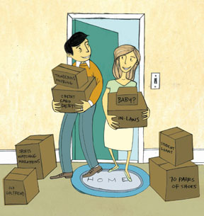
Romantic Partners
Finding Each Other and Living Together
Social Networks
Matchmaking Website Disappointment
Choice Overload
Cohabitation
Longitudinal Research

Slide 30
What makes relationships succeed Conflict
Intimacy

Slide 31
Changes in Marriage Patterns
Ties between marriage and childbearing ‘loosening’.
Less 20-30 yr. olds are married today (12% men, 20% women between ages 20-25).
Fewer adults are married (57%) today compared to any year in the past.
Divorce rate is half the marriage rate.
Factors for good marriage include communication, financial security, and most importantly maturity.
For young wed couples if identity is not achieved first intimacy is elusive according to Erickson.

Slide 32
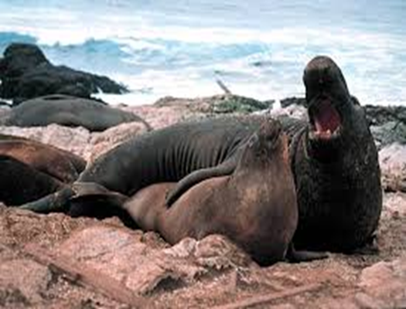
Similarities and Differences
Couples look for ‘like-minded’ mates with similar likes and dislikes.
Homogamy—marriage within same tribe or ethnic group
Heterogamy—marriage outside group.
Social homogamy—have similarity with specific roles and activities.
Experts believe this achievable but say that less than 1 in a 100 will find that ‘compatible’ mate.

Slide 33
Similarities and Differences cont.
Cohabitating couples now vs. cohabitating couples then ( when our parents and g-parents and beyond were living together).
With women driven to forge their place in the workforce, roles have changed.
Women want more men to contribute to home duties (yeah, OK!!), while men want to be more involved in child rearing.
Compromise biggest key here.
Not finding a middle ground leads to more separations.
For those that are able to meet half way and understand each other’s needs relationships are much happier.

Slide 34
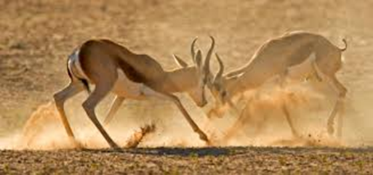
Conflicts
Every intimate friendship can be destructive, even among friendships.
Homicide usually happens from someone close to the victim (friend, relative).
Most couples usually split and go separate ways instead of resorting to violence.

Slide 35
Learning to Listen
Conflict one reason for separations
‘Fighting fair’→ resolution of conflict→ better understanding or resentment.
Demand/withdraw interactions→ one partner insists while the other retreats.
If helpful communication not achieved than this becomes extreme, leading to separations in most cases.

Slide 36
Intimate Partner Violence (abuse)
Communication has become impossible.
12% of men admit the have hit or shoved their partners. 1-3% have threatened with weapons.
3 factors: emerging adulthood (<25 yrs of age), and alcohol and drugs.
Self-deception and dishonesty probably means intimate partner violence is happening much more often.

Slide 37
Intimate Partner Violence cont.
When abuse includes insults, threats, and slaps (in addition to physical violence) then women are just as abusive as men.
Factors for abuse arise from poverty, youth, personality, mental illnesses and drug and alcohol abuses.
Kids who grow up to witness or experience abuse more likely to be abusive.
Situational couple violence vs. intimate terrorism.

Slide 38
Emerging adults and their parents
Intimacy

Slide 39
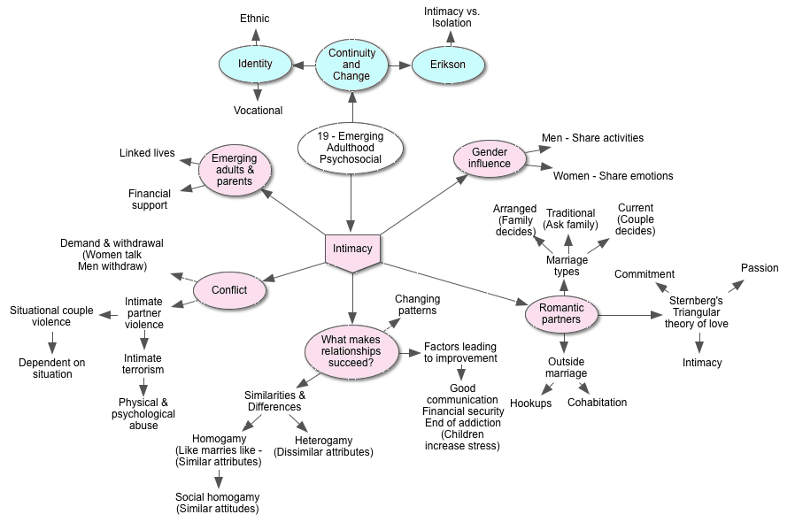
As a family, each member gives meaning to, and provides models for personal aspirations and decisions.

Slide 40
Linked Lives
Experiences and needs of family members at one stage of life are affected by those at other stages.
Emerging Adults still live at home, especially if they are unmarried.
Ages 18-25
Dependent on their parents for support
Parents who encourage children to be independent or to stay home as long as they want differs in each culture

Slide 41
Parents support adult children financially through college tuition payments, free child care, living expenses, and other material support. Parents still make more income than their adult children at this stage.

Slide 42
A Global Perspective
Enmeshment: parents always knowing what their emerging-adult children are doing and thinking.
Intrusive parents may result in less happy and successful children depending on the culture.
Relationships are said to improve when young adults leave home
As young as age 18, American young adults leave home more commonly than in other countries. Freedom from parental limits is often the only benefit. However parents are often not abandoned after their children leave home, as each family member continues to feel obligation to each other.

Slide 43
Finally…
If they postpone marriage, prevent parenthood, and avoid a set career until their identity is firmly established and their education complete, they may be ready for all commitments and responsibilities of adulthood.

